Slide 1
Airport Safety and Quality Review Board
ASQRB
May 31^{st,} 2023
Reviewing March and 2023 YTD Performance
Notes:
What does ASQRB stand for?

Slide 2
Agenda
Special Content
Compliance Monitoring Program
Safety Moment
Safety Accolades
General Updates
Daily Inspections
QCI inspections - Preview
QA Inspections – Preview
Training Compliance Monitoring – Future Addition
Safety Performance
Safety and Quality Updates
Corporate Goals:
Goal #1- Aircraft Damage
Goal #2 – LTI + OSH Data
Top 3 Targets
Engine Hazards
People Safety and Top 3
Significant Safety File Review
Safety Communications
Safety Program Updates
Online Safety Board updates
Safety Round Table
Station and Regional Safety engagement discussion round table

Slide 3
Safety Moment
Pushback Safety
This month’s Safety moment is on Pushback Safety. After recent incidents, an EA system wide read n sign safety bulletin was released May 18th to provide extra guidance for ground crews around pushback procedures.
The read n sign focuses on the following areas:
Tow bar connection / disconnection
Pushback readiness/ hazard awareness and troubleshooting pushback issues.
Headset Communications
Wing Walker Requirements.
Working Safely
Work Safe and within your limits. There are times when we experience a high frequency of flights to service. Slow things down and take each task one at a time, one flight at time.
Follow safety standards and procedures! Standards are in place to ensure the task is completed not only efficiently but safely.
Taking shortcuts often feels like the easier and fastest way to complete a task, but they often lead to an incident or injury and adds time by causing delays or cancelations.
Should you have any questions or need to review any of the processes related to your role, please reach out to a member of your leadership team. We are here to support you!

Slide 4
Safety Accolades
Heaven Caldo - YXE - Once again, our WestJet Station Manager has reported the fact that while conducting an inbound audit of our Ramp performance, your Leadership was graded as PERFECT! She made direct note of your direction to our new employees who were assisting with the marshaling - to NOT approach the aircraft prior to having the beacon turned off!
YLW Support – A huge thank you to all team members that helped support YLW both through Randy’s transition as well as general operations
Notes:
As previously mentioned we are currently working on program within work tango to additionally recognize team members that are mentioned on safety accolades, updates will be provided on every ASQRB until the program is ready for launch

Slide 5
General Updates
The Safety Team is working on a number Safety Program and Policy Updates:
Safety Reporting Policy.
There will be an update in June to this policy with additional emphasis on submitting incidents into Vortex after notifications from external parties. Examples include Airport Authorities, Airline Partners, Regulatory bodies.
Safety Risk Hazard Policies.
There will be an update in June to these policies. You may have seen new Hazard Severity level colour coded boxes in the incident system. We are currently working on the process for risk rating incidents/ requirements based on rating/ severity.
Training Management Plan 1.3.5 requirements.
A new work order requirement and communication will be release in June to complete the requirements of the New Training Management Plan 1.3.5 - Manager Responsibilities update. Graham will review this later in the presentation.
Safety Dashboard Portal.
Ongoing work to improve the Safety Dashboard page. Graham will review this later in the presentation.
Peak Season Readiness (Summer)
The Safety Team will release information on station preparedness for safety in June- With heavy Focus on OSH.

Slide 6
Airports Safety and Quality Review Board
Special Content Questions?

Slide 7
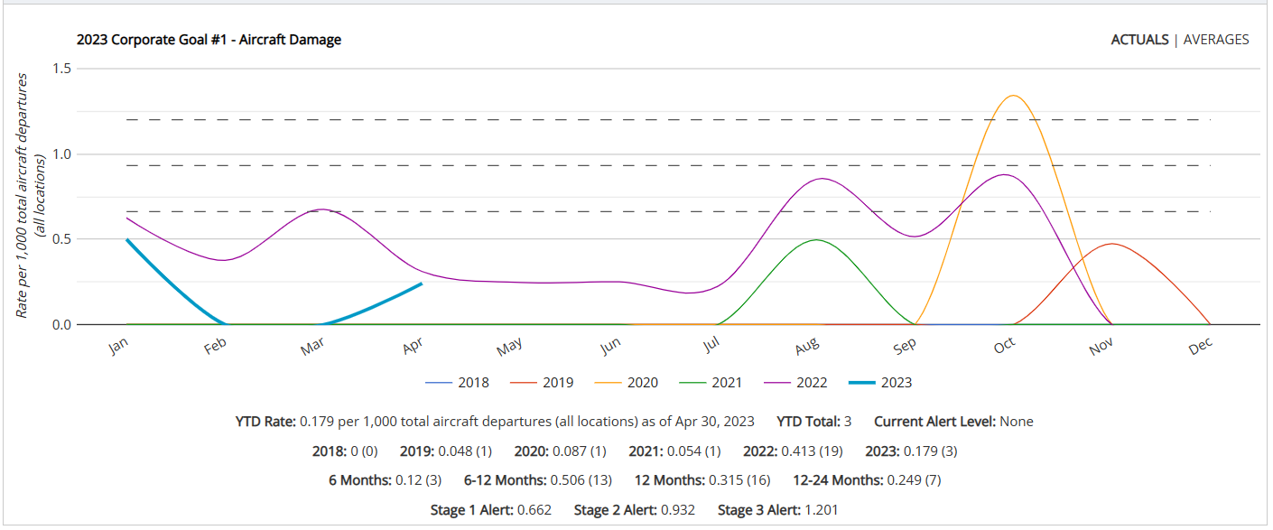
Goal #1 – Aircraft Damage
2023 Target – 0.392
2023 Actual – 0.179
Notes:
The 2023 Corporate Safety Goal for Aircraft Damage is 0.392 rate per thousand. This is set at a 5% reduction (improvement) from 2022 rate of 0.413

Slide 8
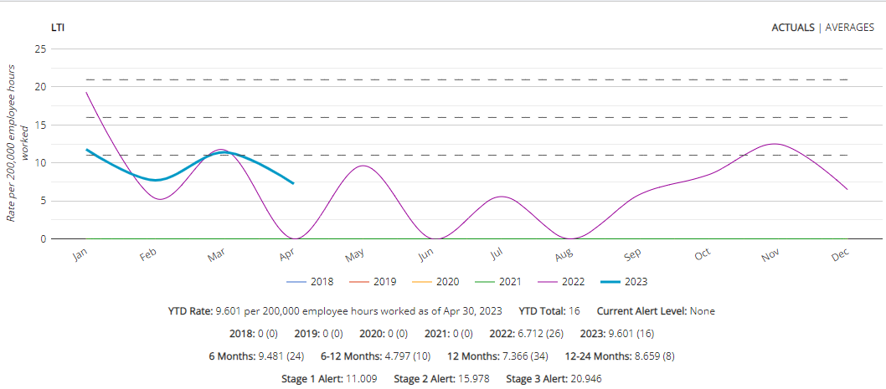
Goal #2 – LTI
2023 Target – 6.712
2023 Actual – 9.601
Notes:
16 LTI YTD

Slide 9
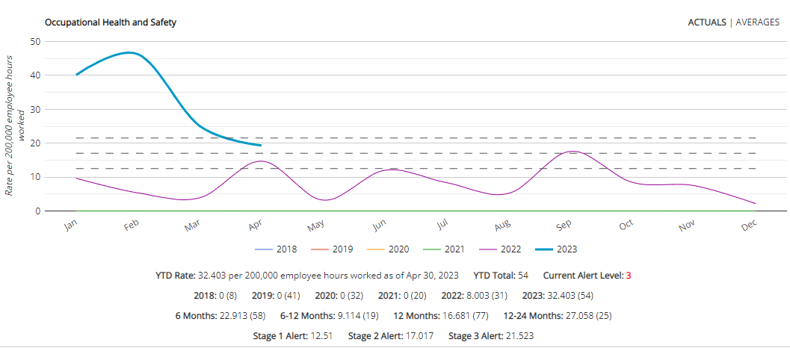
Occupational Health and Safety
Notes:
Numbers continue to move in a downward trend consistent with weather changes.

Slide 10
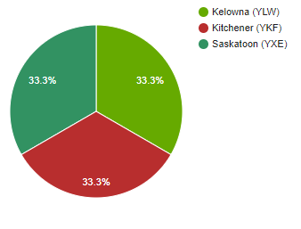
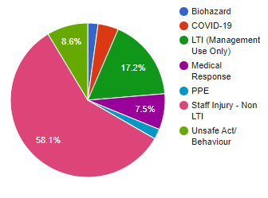
Goal #2 – OSH Data
April - 3 LTI Reports
YTD - 93 OH&S Reports – (Staff Related)
April - 13 OH&S events - (Staff related Includes LTI)
YTD - 54 reports for:
Slips/Trips/Falls -19
Sprain - 5
Push/Pull -3
Lift/Carry – 6
Twist/Bend -2
Other - 19
Top 3 stations YTD
YAM - 16
2. YHM –12
3. YXE – 11
2023 YTD - 16 LTI Reports
1. YHM – 4
2. YXE – 4
3. Multiple Stations - 1
Notes:
April 2023
OH&S EVENTS
93 OH&S Staff Related Reports YTD
13 OH&S Staff Related reports filed in April
1 x PPE Not worn and 1 x Unsafe act
Staff Injuries Non LTI events – 8 events
1 each for sprain and 1 twist/bend
Other – 2 x hit face, 1 x hand caught/crush, 1 x reaction to spices, 1 x leg, 1 x hand cut.
3 LTI events for April 1 each for Saskatoon, Kitchener, Kelowna
12 Committee meetings planed – 8 completed – 66%
Safety Inspections - BTW – 15 of 19 completed - 79%
ATW – 12 of 21 completed - 58%
FBO – 4 of 4 completed -100%
SHOP – 3 of 4 completed – 75% YXE
Canada Labour Code in the Portal under TM quick links

Slide 11
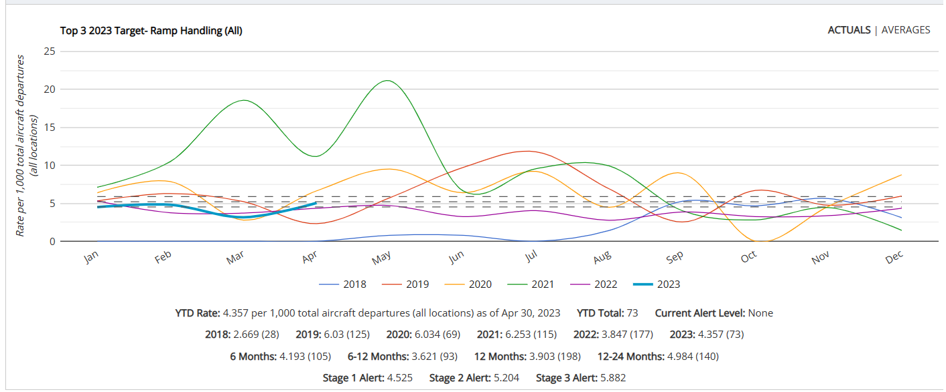
Target #1 – Ramp Handling
2023 Target – 3.847
2023 Actual – 4.357

Slide 12
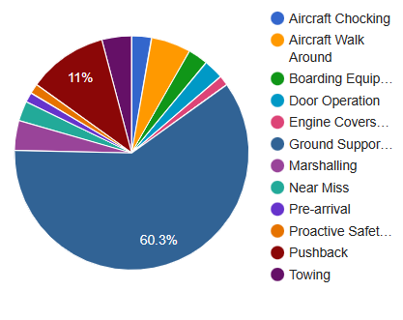
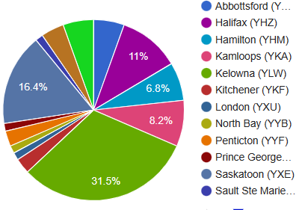
Target #1 – Ramp Handling
YTD –Jan 1 –, April 30th, 2023
YTD- 73 Incidents
Top 3 by descriptor category:
Ground Support Equipment Operation- 44
GSE Maneuvering – 13
Collision GSE to GSE- 8
Collision with Airport Infrastructure- 7
Push Back –8
Aircraft Walk Around- 4
YLW – 23
YXE - 12
YHZ – 11

Slide 13
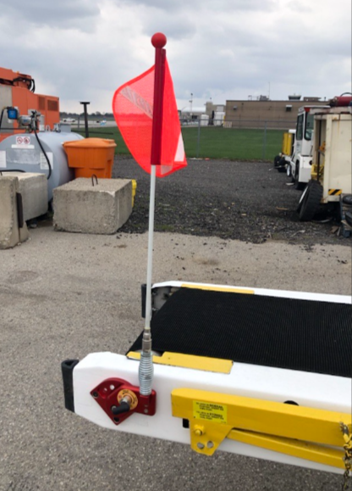
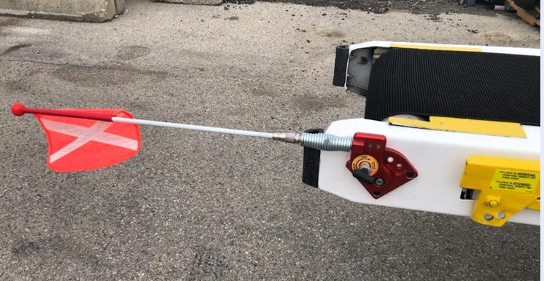
Ramp Handling
Example - Technology Enhancements
***NEW*** - GSE Operation Working Group Concept
A working group will be formed of volunteers across the organization – To look at ways of reducing our GSE Operation safety incidents
Volunteers (depending on station structure)- would include SM's, Operations Managers, RC's, Trainers. OSH Reps, Training Team and the GSE Team.
Graham Lindsay will be Leading the working group.
The Working group will be an ongoing program for 2023. This would include multiple sessions.
The working group progress will be reviewed at the ASQRB.
Timeline:
May – Volunteer requests will go out
June - The Safety Team will prepare all historical data and set up the format for the working group.
June - Working Group Team members will be identified
June - Session #1 Scheduled
Session #1
Review of Historical data to determine (statistically) areas of safety incident focus – Example – Contact with Airport Infrastructure.
Brain storming session to look at areas of opportunity.
Notes:
-Due to commitments and investigation requirements we have had to move most of the round 1 action items to June however the email for volunteer requests has gone out

Slide 14
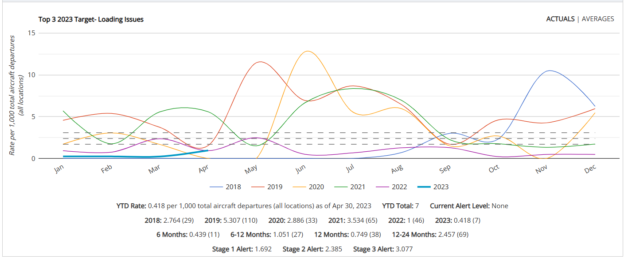
Target #2 – Loading Incidents
2023 Target – 1.0
2023 Actual – 0.418

Slide 15
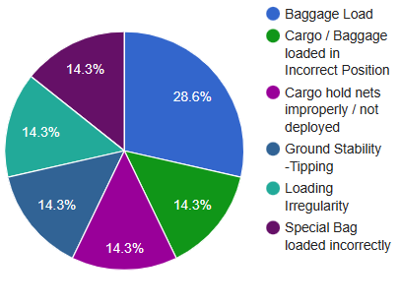
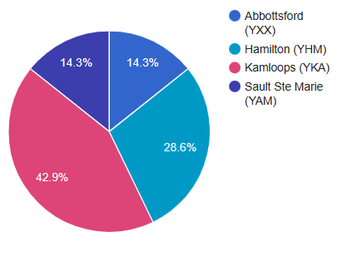
Target #2 – Loading Incidents
YTD –Jan 1 – April 30th 2023
YTD- 7 Incidents
Top 3 by descriptor category:
Baggage Load - 2
Loading irregularity -1
Cargo/ Baggage Loaded into incorrect Position –1
Special Baggage Loaded incorrectly – 1
Cargo Hold Netting – 1
Ground Stability Tipping-1
YKA- 3
YHM-2
YXX-1
YAM-1

Slide 16
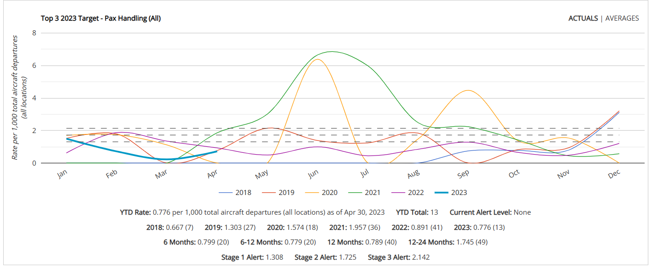
Target #3 – Pax Handling
2023 Target – 0.891
2023 Actual – 0.776

Slide 17
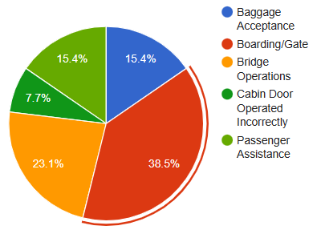
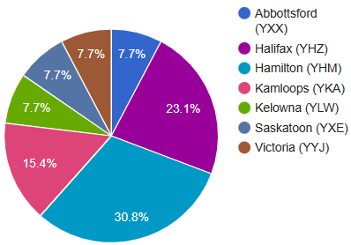
Target #3 – Pax Handling
YTD –Jan 1 – April 30th 2023
YTD- 13 Incidents
Top 3 by descriptor category:
Boarding Gate –5
Bridge Operations-3
Baggage Acceptance – 2
Passenger Assistance-2
YHM – 4
YHZ - 3
YKA- 2

Slide 18
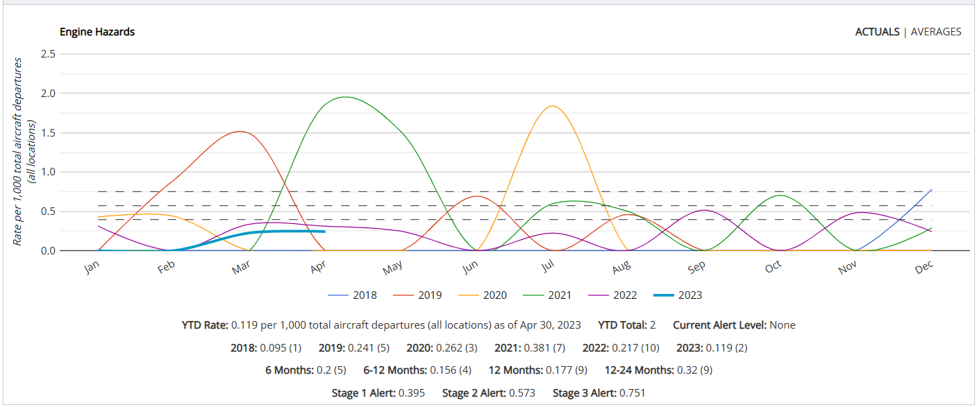
Engine Hazards
2023 Actual – 0.119
Notes:
YLW- 1 – combination error between EA/ WJ pilot (risk as prop started during walk around)
YXE- 1 – April- Ramp agent approached engine before all clear

Slide 19
Airports Safety and Quality Review Board
Corporate Goal and Targets Questions?
Notes:
Poll Question – General Questions / Comments

Slide 20
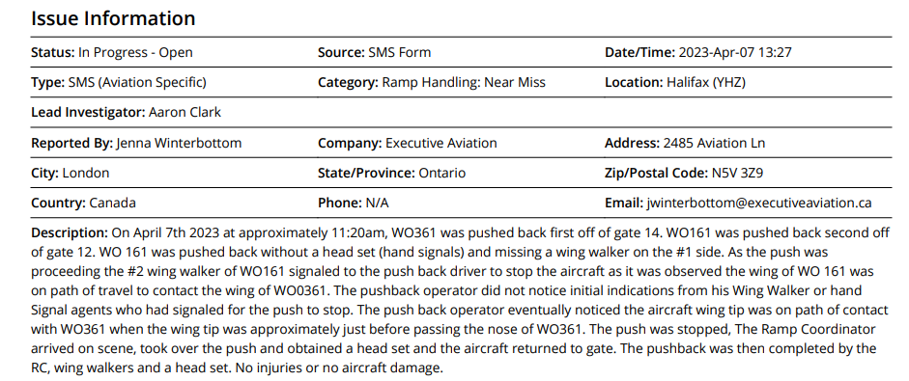
Safety Issue – YHZ Near Miss
2023-0040
Contributing Factor #2: The person conducting the task did not follow standard practices in conducting the task
Explanation: The Lead agent for WO 161did not have a working headset for the pushback. The Lead agent for WO 161 did not have an agent to perform the hand signals and the decision was made to utilize the wing walker from #1 side.
Root Cause: The Lead agent was unaware of the pushback requirements for headsets and the requirement for wing walkers could not be altered to accommodate task completion. Enforcement of these standards need's improvement
Contributing Factor #3 Safe working procedures/practices were not observed.
Explanation: The Lead agent pushed WO161 in a directional path that caused a hazard (contact) with WO 361. The Lead agent did not keep visual contact with his #2 wing walker or agent performing the hand signals. Both agents signaled to the lead to stop the push which was not followed.
Root Cause: The Lead agent did not follow standard practices for wing walkers to assist him during pushback. The lead agent ignored standard practices once the pushback experienced a deviation. Not maintaining visual contact with his wing walker caused a hazard with Swoop WO 161. Enforcement of this standard need's improvement.
Contributing Factor #1: The person conducting the task was not proficient or did not understand the task.
Explanation: The agent who was performing the hand signals was not proficient and had identified prior to the task to his lead that he was not comfortable
Root Cause: The Lead Agent was feeling a internally generated pressure for on time performance to push the aircraft and intern put pressure on the agent to perform the hand signals. The agent advised he was not comfortable to perform this task, but after this pressure from the lead he agreed. Task completion on the ramp should not be performed at the expense of safety procedures regardless of the external pressures to complete them. Enforcement of safe working procedures need's improvement.

Slide 21
Safety Issue – YHZ Near Miss
2023-0040
Long Term Actions
Hand signal signage posted throughout the office. ~YHZ to hold review sessions with agents to ensure understanding ~Communication issued to all ramp staff to communicate importance of pushback SOP's ~ Maria and Victoria to conduct training audits to confirm that content is clear and thorough (Due date June 15th)
Headsets were available and fully operational. ~Communicating with all ramp personnel on the importance of SOP's via group chats, safety briefings, and communications. ~Spot checks for 30 days to confirm headset compliance
01 May- Maria addressed current initial class to outline safety expectations. Highlighted that agents MUST have received appropriate training for any task they are completing, and they are expected to refuse tasks for which they aren't trained. Advised that we prefer to take a delay to ensure that the task is complete to standard. ~Team chats to discuss expectations of safety over OTP,and ensuring that all agents know they will be supported if a safety time out is needed.
System Actions:
Pushback Safety Read N Sign issued May 18th: Focused on:
Tow bar connection / disconnection
Pushback readiness/ hazard awareness and troubleshooting pushback issues.
Headset Communications
Wing Walker Requirements.
System wide plan to ensure all pushback tractors have a pelican case and functional headset per unit.
Short Term Actions​
​
A safety flash to highlight headsets, hand signals and hearing protection was issued to the Team

Slide 22
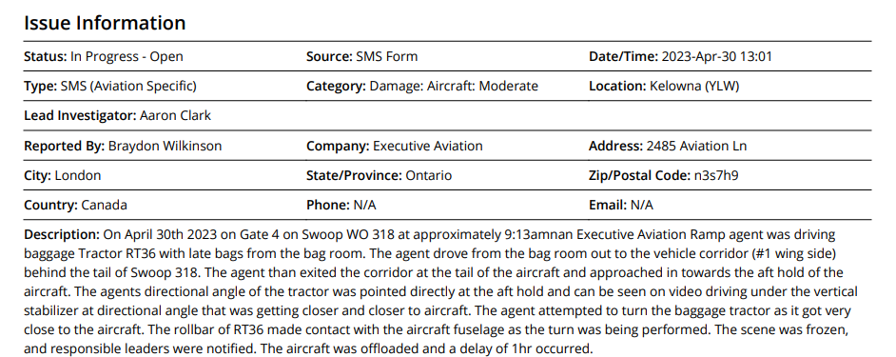
Safety Issue – YLW WO AC Damage
2023-0045
Root Cause: The Executive Aviation ramp operations is consistently not following Swoop GOM 5.2.1 Belt Loader requirements due a lack of awareness to the standard and or enforcement of the standard. Enforcement of GOM Standard 5.2.1 needs improvement
Contributing Factor #2: The person conducting the task did not follow standard practices in conducting the task.
Explanation: The agent driving baggage tractor RT36 did not follow Swoop GOM standard 5.5.1- do not position motorized GSE that is not required to mate with the aircraft within 3m (10ft) of the aircraft
Root Cause: With the identified trend of not utilizing a belt loader to load the aft cargo hold with small quantities of bags it has been common practice to circumvent GOM standard 5.5.1 by trying to position the baggage cart as close to the aft cargo hold as possible- to make it easier to hand load the aft cargo hold. Enforcement of GOM standard 5.5.1 needs improvement. Communication to EA ramp operations team member that not following safety procedures to complete tasks is not permitted needs improvement.
Contributing Factor #1: The person conducting the task was not proficient or did not understand the task.
Explanation: The Executive aviation agent driving baggage tractor RT36, and the EA Lead did not follow Swoop GOM standard 5.2.1 - a minimum of one Belt Loader must be used on all Swoop Aircraft. If only one belt loader is available, it should be used to assist with the loading and unloading of the aft cargo hold

Slide 23
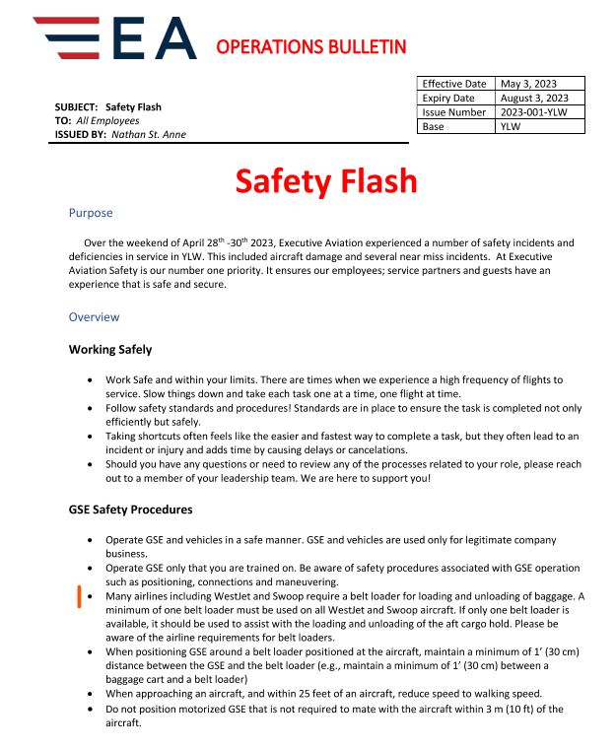
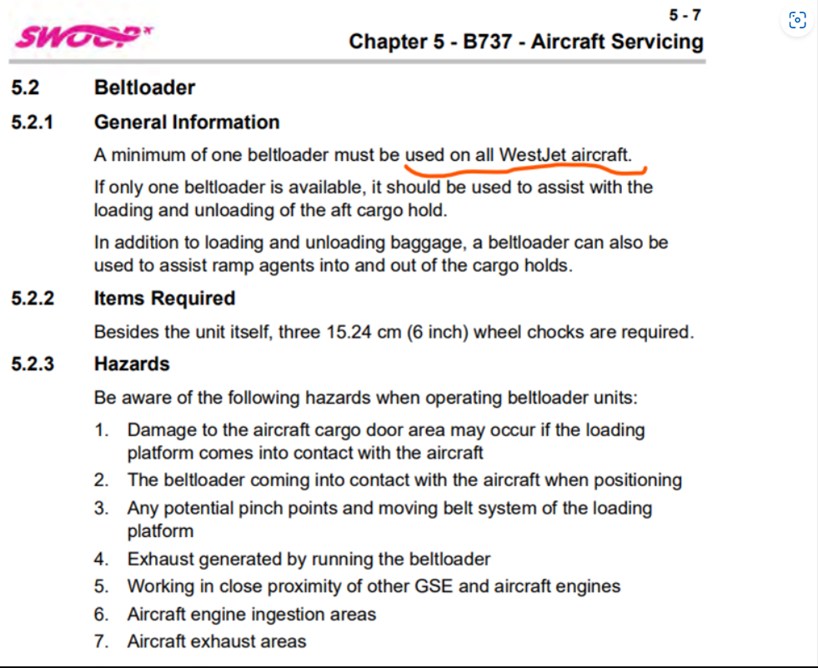
Belt Loader Standards

Slide 24
Safety Issue – YLW WO AC Damage
2023-0045
Short Term Actions​ Cont...
​
Daily Crew Briefings on Swoop Operating Days have been performed by on site SM support from May 4th- May 28th
The agent who operated the baggage tractor during the incident will not be working Swoop flights and is not permitted to operate GSE pending investigation.
YLW saw a lot of support from our corporate team and other airport leaders to support YLW during Randy's transition
Long Term Actions
EA agent to be retrained on applicable GSE- Baggage Tractor and Belt Loader prior to working Swoop/ WestJet product. This includes emphasis on the Swoop GOM Standards 5.5.1 and 5.2.1.
The Safety Flash that was released to the YLW team May 4th, 2023- outlined the requirements for Swoop GOM process 5.5.1 and 5.2.1. This is the communication piece #1. The EA YLW RC and Operations Manager will continue to hold crew briefings (extension to the short-term CAP) on these 2 standards prior to every Swoop Flight (on operating days) for 30+ days (June 1st - June 30th)
\ 2 QC audits are being performed on Swoop from May 4th- 28th (short term CAP). A minimum of 1 Quality control audit per week will be performed for 30+ days starting June 1st – June 30th ). Focus of these audits will be on WO GOM 5.51 and 5.2,1. These audits will be documented for compliance review. Any agents demonstrating non-compliance to these standards will be required to complete GSE training recertification (including a standard review).
A Bi- weekly CAP status call will be scheduled internally May 29th, Jun 12th, Jun 26th. This is to ensure that CAP actions are on track and that documentation are complete.
Short Term Actions​
​
A Safety Flash was created as a read n sign and was issued May 3rd
Swoop QC audits conducted 2 timer per week (May 4th – May 28th by a member of our YLW on site leadership team. The QC’s will be documented and reviewed for findings/ compliance. The QC’s will be uploaded into the CAP documentation

Slide 25
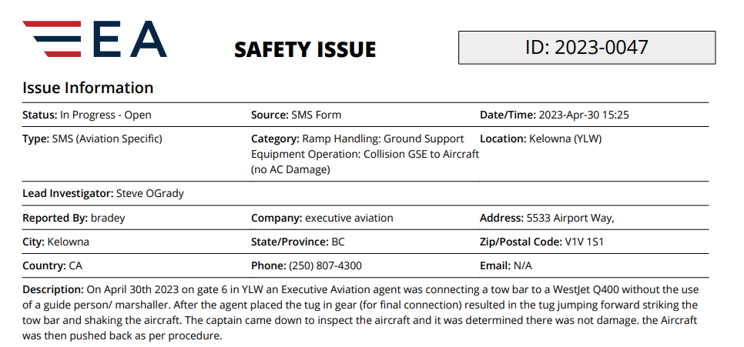
Safety Issue – YLW Pushback jumped forward during tow bar connection
2023-0047
Short Term / Long Term Actions​
​
All short-term corrective actions implemented form Safety File 2023-0045
All long-term corrective actions implemented form Safety File 2023-0045
EA Agent involved received new pushback certification via the trainer
EA Agent involved will receive 4 pushback audits to validate effectiveness of re-certification.
Contributing Factor #1: The person conducting the task did not follow standard practices
Explanation: Executive aviation agent did not follow WestJet Q400 Procedure/ Standard (WJ GOM 13.6.3.1) - Marshall in the pushback and attach to the towbar hitch.
Root Cause: The EA Lead elected to make a connection by himself (deviating from process) instead of waiting for assistance from other team members. Communication and enforcement to EA ramp operations team member that not following safety procedures/ standards to complete tasks is not permitted - needs improvement
Notes:
CAPs are in development with Station Manager and EA safety Team - Thomas

Slide 26
Airports Safety and Quality Review Board
Safety Performance Questions?

Slide 27
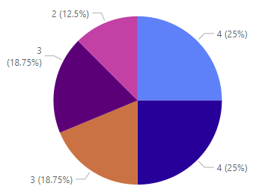
BTW QC Audit Activities
Major Findings
- No major findings
Trends YTD

Slide 28
Station QA Audit Activities
Station QA Audit Results
Major Findings
Date | Station | Internal/ Airline | Findings | Major Findings | Findings-BTW | Findings- ATW | Observations
No major findings
Scheduled Audits
Trends
Date ​ | Station​ | Internal/ Airline​
​
​ | ​ | ​
No Trending Items

Slide 29
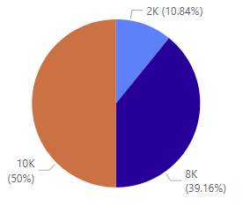
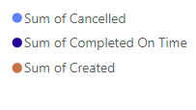
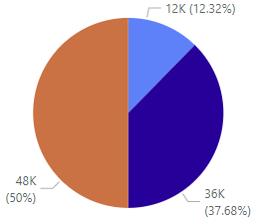
Daily Inspections
April Year To Date
Bottom 3 Stations
Station | Completed on time %
Masset (ZMT) | 0%
Kelowna (YLW) | 55%
Halifax (YHZ) | 60%
Top 3 Stations
Station | Completed on time %
Kamloops (YKA) | 100%
Kitchener (YKF) | 98%
Prince George (YXS) | 98%
West Kootenay (YCG) | 97%
Notes:
Improved completion rates
April – 78% completion rate, overall completion rate up 3%
YTD – 75% completion rate
fourth month in a row Kamloops is at a 100% completion rate
Masset has put a lot of attention into the daily inspections and although this was the second month with them at 0, for the current month they are sitting at over 70%
With the attention YHZ has put into this they are currently sitting at over 90%
Kelowna has also put effort in to improving their inspections, currently sitting at 0ver 60% for the month, their will be a review completed in YLW of all equipment
Although the progress may seems slow overall there has been a good improvement with the completion rate, May is currently sitting at 85%

Slide 30
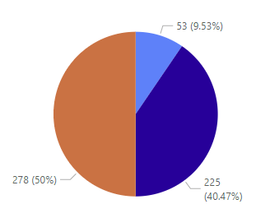
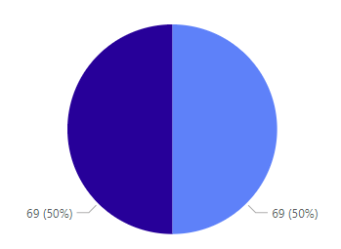
PCI Compliance
April Year To Date
100%!
Notes:
ALL STATIONS AT 100%
Top 3 / Bottom 3 tracking will begin the next time a station does not hit 100%

Slide 31
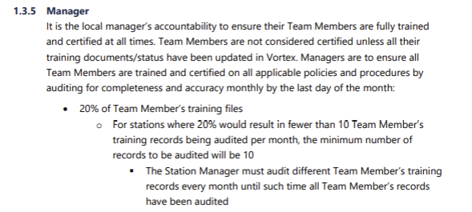
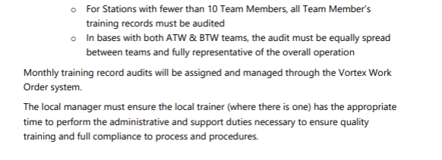
Safety and Quality Updates

Slide 32
Safety Dashboard Portal
Updates on Safety Dashboard Portal
Notes:
Coming updates
ATW audit tracker
BTW audit tracking method changing to ensure correct data is being displayed
Monthly Safety Inspection work orders being updated, Shop and FBO data to be displayed, fixing tracking for committee meeting work orders

Slide 33
Safety and Quality Updates
Notes:
Pushback Safety reviewed
Pushback connection and disconnection processes – this does require 2 team members
Communication requirements
How to manage events that could take place during pushback (i.e pushback aircraft separation, shear pin failure)
Awareness piece for departures – things to be aware of, direction of travel of aircraft and effects of jet blast, position of adjacent aircraft, high winds, deplaning paths etc Wing walker requirements
Air Quality Awareness
Provides links for assessing the day to day air quality within the provinces
Was released to the west locations, will be released to Atlantic province stations
The links can be used to obtain the most up to date data on air quality
Recommended use of N95 for best available protection during poor quality days

Slide 34
Safety Action Log
Category | Status | Identified/Trend | Factors | CAP/Mitigation
OSH- Body Mechanics Program(s) | In Progress | Identified need for BTW body mechanics program and review of existing programs | There is currently ATW online body mechanics training – But not for BTW. The goal would be to implement/ review programs to help reduce injuries. | Exploration Phase
OSH- Peak Season Readiness Programs | In Progress | Identified need for Peak Season Readiness program | Working in various weather conditions creates a several OSH Hazards - Slips/ trips and falls, extreme cold conditions, Extreme Heat etc | Initial Discussion with Lionel/ RM- Meeting Schedule Information documentation started Delivery plans to be determined
Ramp Handling- GSE Operation | In Progress | GSE Operation represents +50% of all Ramp Handling incidents | GSE to GSE contact/ GSE to facility contact/ GSE to AC contact/ GSE maneuvering/ GSE towing | Exploration Phase GSE Operation - Working Group- June
Ramp Handling Pushback *New* | In Progress | Recent Incidents have identified areas for improvement | Tow bar connection / disconnection Pushback readiness/ hazard awareness and troubleshooting pushback issues. Headset Communications Wing Walker Requirements. | Pushback Safety Read N Sign issued May 18th: System wide plan to ensure all pushback tractors have a pelican case and functional headset per unit.
Engine Hazards *New* | In Progress | Recent Incidents have identified areas for improvement | Engine Spool Down Prop feathering Anti- collision light All Clear signal Engine start up | Exploration Phase

Slide 35
Round Table

